Slide 1
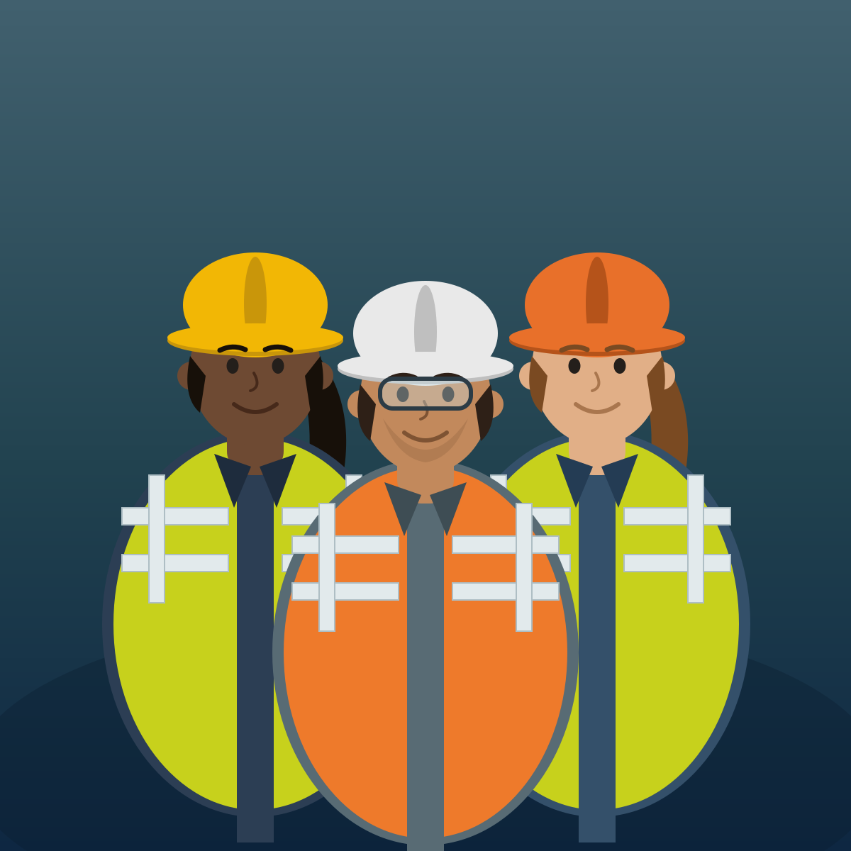
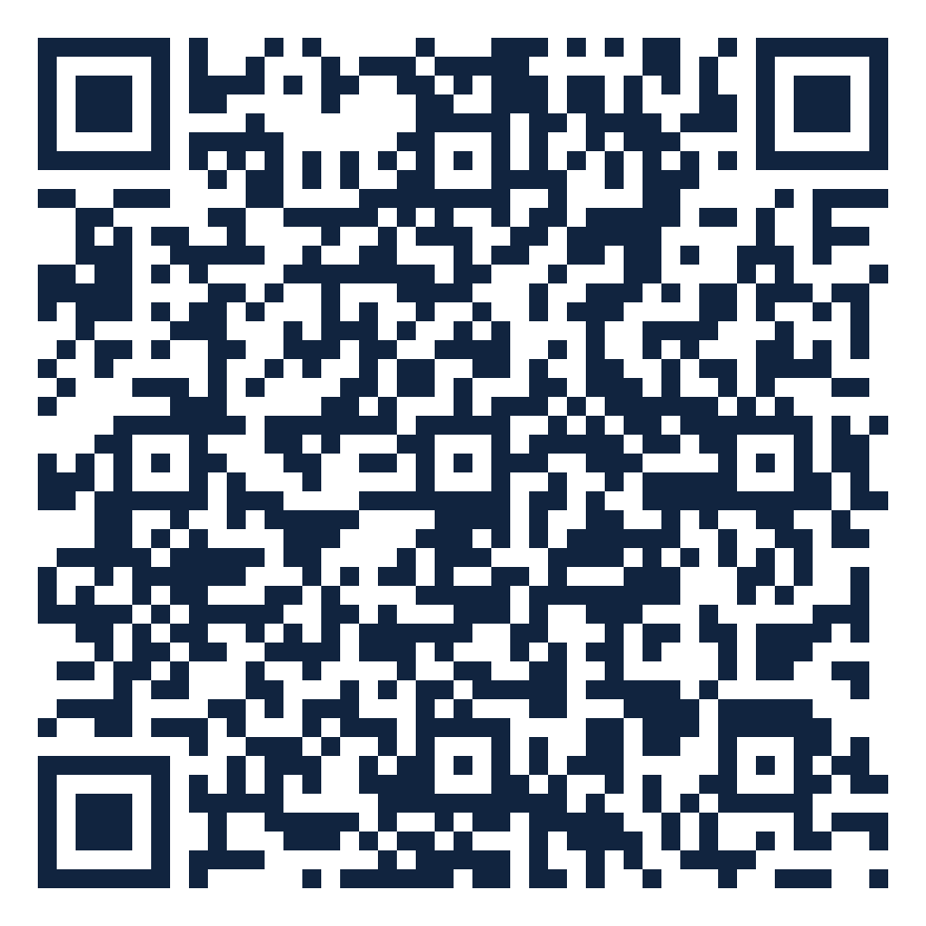
ORGANIZATIONAL TRUST QUOTIENT®
Reading team health
from everyday messages
How people talk at work → a signal of how the team is doing
Scan to open in Colab
Vernon T. Cox · Srilatha Alla
CNM Ingenuity — Data Science Bootcamp Capstone
Instructor: Robert Citek
SME: Prof. R. DelCampo — UNM Anderson
Notes:
Hi, I'm Vernon Cox, with Srilatha Alla. Our project asks a simple question: can the way a team communicates tell us how healthy the team is? We read everyday message patterns — not the words — and turn them into a signal. The QR code opens our notebook runnable in Colab. About 30 seconds.

Slide 2





PREVIEW — WHAT WE'LL COVER
The next 8 minutes
Scan · Colab
1
The problem we set out to solve
2
What OTQ looks at
3
The data — and how we score it
4
Results & the dashboard we built
5
Take-homes & what's next
02
Notes:
Tell 'em what we're gonna tell 'em. Five beats: the problem, what we look at, the data plus our scoring, results and the dashboard, then take-homes and next steps. 20 seconds.

Slide 3

THE PROBLEM
Trust is hard to see — until it's gone
Scan · Colab
The usual way: a yearly survey
DAYS BETWEEN CHECK-INS
365
Only once a year — misses problems as they build
People answer how they “should”
Takes time away from work
Teams send thousands of
messages a day — unused
Our goal: an always-on read — with no extra work
03
Notes:
The problem in plain terms. Trust decides whether people speak up early or share half-finished ideas. But we usually only check once a year, with a survey that's slow, biased, and disruptive. Meanwhile teams already produce thousands of signals a day. Our goal: use those, with no extra work.

Slide 4

WHAT OTQ LOOKS AT
From “how people talk” to “how the team is doing”
Scan · Colab
→
→
WE MEASURE
WE PREDICT
WE'RE AFTER
Engagement
Responsiveness
Trust
how much people talk & meet
how fast they reply
the thing underneath — inferred
Being honest: we measure talk and predict replies. Trust is what we believe sits underneath — we don't claim to measure it directly.
04
Notes:
What we actually look at — and our reviewer's key point. We measure engagement (how much people talk and meet), we predict responsiveness (how fast they reply), and trust is the thing underneath that we're really after. We're careful not to overclaim: we don't say we measure trust directly.

Slide 5





THE DATA · WHERE IT COMES FROM
Three everyday tools, one combined table
Scan · Colab
→
Slack
Teams
Outlook
106 events
in one table
56 chat messages
30 meetings
20 calendar invites
Practice data: the “Apostles” dataset
No real company yet — so we built safe stand-in data from Bible figures (the apostles). Same shape as real Slack / Teams / Outlook exports, so the code is ready for the real thing.
05
Notes:
Where the data comes from. We pull from the three tools people already use — Slack, Teams, Outlook — and merge them into one table of 106 events. Since we don't have a real company's data yet, we built safe practice data from Bible figures, the apostles, in exactly the same format a real export would have.

Slide 6

THE DATA · WHAT'S IN IT
Each row is one interaction — counts, not words
Scan · Colab
Source | Type | Who | Channel | Min | People | Score
Teams | meeting | Peter | council | 60 | 12 | 30.9
Slack | chat | Paul | epistles | 0 | 2 | 11.0
Outlook | meeting | James | assembly | 90 | 8 | 30.5
Slack | chat | John | acts | 0 | 4 | 12.5
What we keep
Who & where
How long
How many people
A reply-speed clue
Sample rows from the combined table. Names/channels are labels in the data — never message content.
106
3
8
events
sources
fields each
06
Notes:
This is the heart of the data. Each row is a single interaction with a few plain facts: which tool, what type, who, where, how long, how many people, and a reply-speed clue. Crucially, we keep counts and timing — never the contents of any message. 106 events, 3 sources, about 8 fields each.

Slide 7

THE DATA · HOW WE SCORE IT
Give every interaction a score
Scan · Colab
Bigger score = more engagement. Meetings count more than emails; longer and more people count more.
Score one event
Start: type of interaction
Add: how long it ran
Add: how many people
Add up each day
Total score & # of events
Avg people & length
How much was written
07
Notes:
How we turn interactions into numbers. Every event gets an engagement score: start with the type — meetings count most, email least — then add a little for how long it ran and how many people were involved. Then we add everything up per day to get daily team numbers. All the rules are simple and visible.

Slide 8


THE MODEL
A steady model that connects the dots
Scan · Colab
What it does
How we checked it
Learns: engagement → reply speed
Our clues overlap — needs to stay steady
Ridge regression keeps it stable & readable
Compared against other models
Tuned the settings carefully
Tested on days it never saw
Ranked which clues matter most
08
Notes:
Our model in plain terms. It learns the link between engagement and reply speed. Because our clues overlap a lot, we used Ridge regression — a model built to stay steady and stay readable when that happens. And we didn't trust one run: we compared other models, tuned settings, tested on days it had never seen, and ranked which clues mattered most.

Slide 9
RESULTS
More engagement → faster replies
Scan · Colab
THE HEADLINE
When a team is more engaged, they reply faster — just as we expected.
Practice data — the pattern is real; exact numbers will change with a real company
09
Notes:
The result. The line shows our prediction tracking the real reply-speed in the practice data. The headline anyone can take away: when a team is more engaged, they reply faster — exactly what we expected. Be honest that this is practice data, so the pattern holds but the exact numbers will move with a real company.

Slide 10



WHAT WE BUILT
A website that runs the whole thing
Scan · Colab
organizationaltrustquotient.com
Upload the files
It runs everything for you
Drop in the files
Accuracy
Reply time
Top clues
See results & charts
charts come back automatically
Day-by-day predictions
10
Notes:
What we built beyond the notebook: a simple website. You drop in the files, it runs the whole pipeline for you, and the results and charts come right back — including day-by-day predictions. Someone with no coding background can use it.

Slide 11

TAKE-HOME POINTS
What to remember
Scan · Colab
Always-on beats once a year
Talk predicts replies
a live read, not an annual survey
more engaged teams answer faster
We're honest about it
Private by design
we measure talk, not trust itself — yet
counts & timing only, no message content
11
Notes:
Tell 'em what you told 'em. Four take-homes: always-on beats once a year; how people talk predicts how fast they reply; we're honest that we measure talk, not trust itself yet; and it's private by design — counts and timing only, never message content. If they remember one slide, this is it.

Slide 12


WHAT'S NEXT
Next steps & questions
Where we go from here
Questions?
Check our score against a trusted trust survey
Use a real company's data
Give each team & person their own score
Track real outcomes (deadlines, tickets)
Vernon T. Cox · Srilatha Alla
Instructor: Robert Citek — CNM Ingenuity
SME: Prof. R. DelCampo — UNM Anderson
Scan to open in Colab
12
Notes:
What's next and questions. The big next step is checking our score against a trusted, validated trust survey on a real team — that's what would let us truly say 'trust.' Then real company data, scores per team and person, and tracking real outcomes. The QR code opens the notebook in Colab. Thank the instructor and SME, and open the floor.

